Slide 1
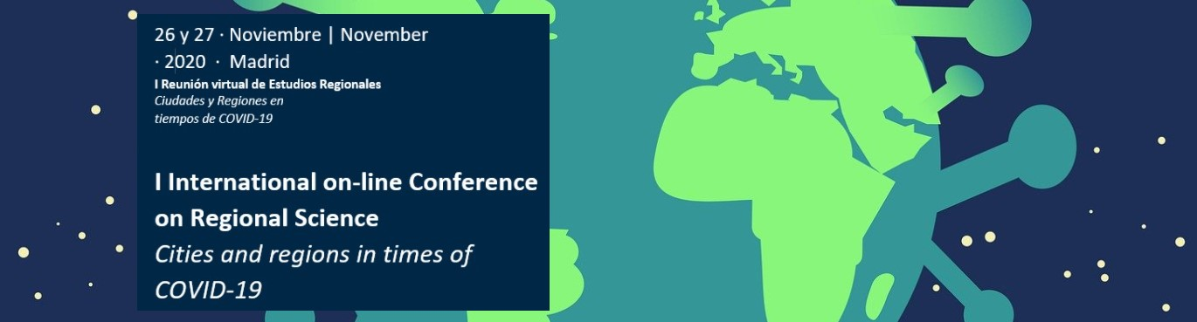


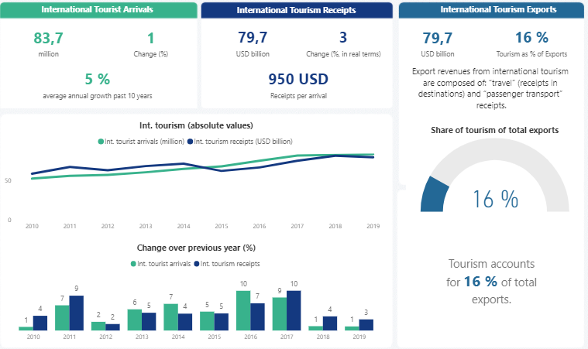
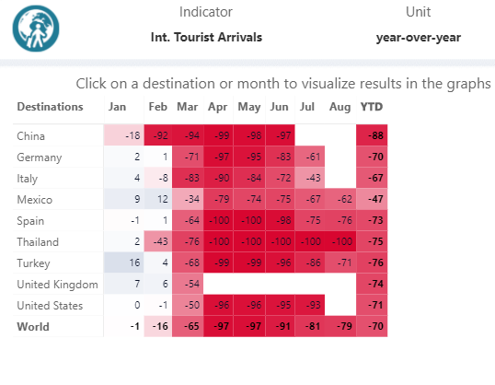
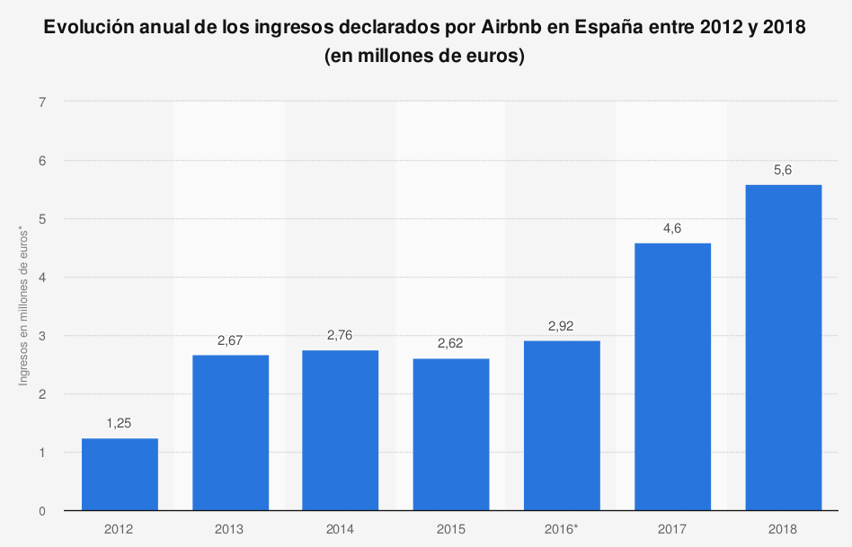
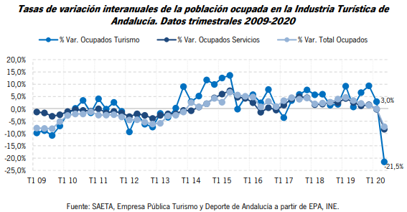
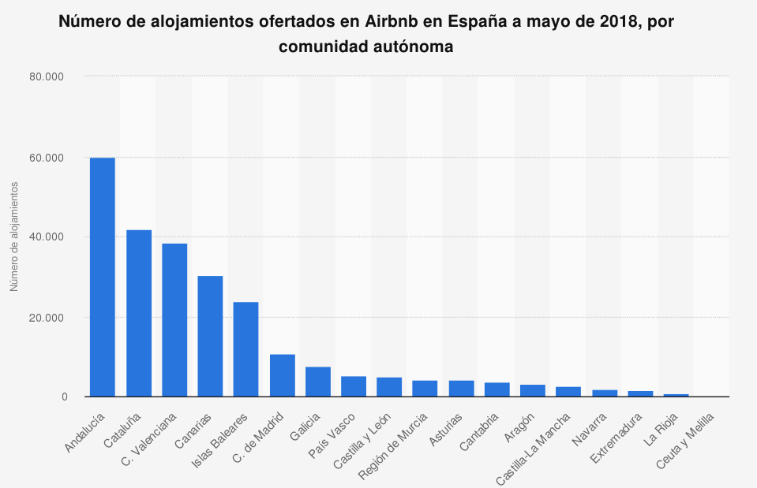
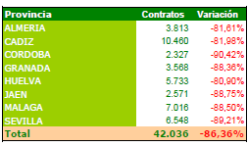
URBAN ECONOMICS TOURISTIFICATION: AIRBNBISATION OF CITIES FROM ANDALUCIA
Laura Serrano
Universidad Loyola Andalucía, lserrano@uloyola.es
OBJECTIVES
METHODOLOGY
Symptom
Airbnb
p2p model vs commercial model
Hyper-dependence urban tourism economy
Cadiz Granada Malaga Seville
STR tourist accommodation Airbnb in four cities of Andalusia more tourist arrivals annually
Diagnosis
Impact of the touristification of the urban economy of cities
Context
COVID 19
Comparison and evolution economic data
2 scenarios: pre-pandemic- pandemic
GRAPHS AND TEXT
RESULTS
Pre-pandemic
Pandemic
Expansion of tourism and the real estate business go hand in hand in the process of touristification of the economy
Touristification of the urban economies occurs together with the accelerated process of "airbnisation" of the residential housing market
Serious impacts on the social and economic sustainability of the city
Center economies capital-intensive sectors
Peripherics economies labour-intensive sectors as tourism
Neoliberal local development strategies
Social and economic segregation
the periphery is at the service of the center
CONCLUSIONS
REFERENCES
Adamiak, C., Szyda, B., Dubownik, A., & García-Álvarez, D. (2019). Airbnb Offer in Spain-Spatial Analysis of the Pattern and Determinants of Its Distribution. ISPRS International Journal of Geo-Information.
Cocola-Gant, A., & Gago, A. (2019). Airbnb, buy-to-let investment and tourism-driven displacement: A case study in Lisbon. EPA: Economy and Space.
Gil, J. (2019). Cambios en la producción y el consumo del turismo. El caso de Airbnb. In E. Cañada & I. Murray (Eds.), Turistifación global. Perspectivas críticas en turismo (Antrazyt 4, pp. 325–342). Barcelona: Icaria.
Gil, J., & Sequera, J. (2020). The professionalization of Airbnb in Madrid : far from a collaborative economy. Current Issues in Tourism.

