Slide 1
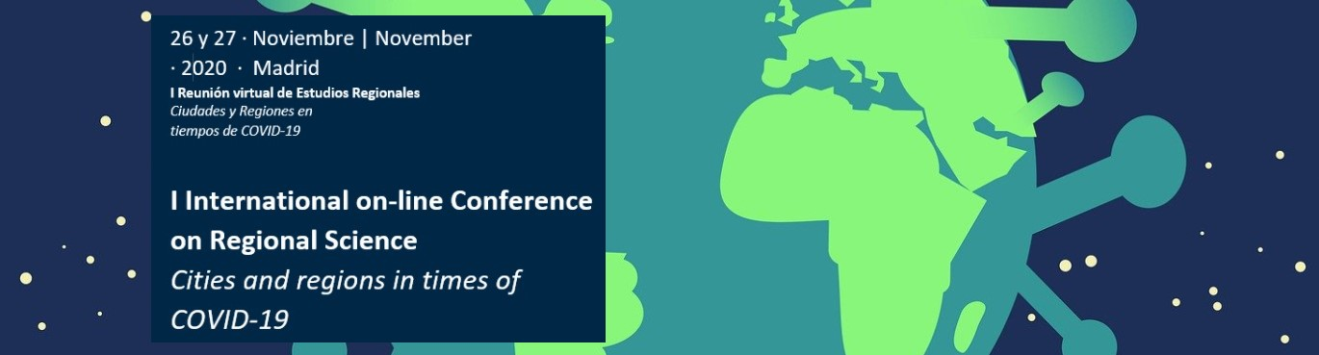
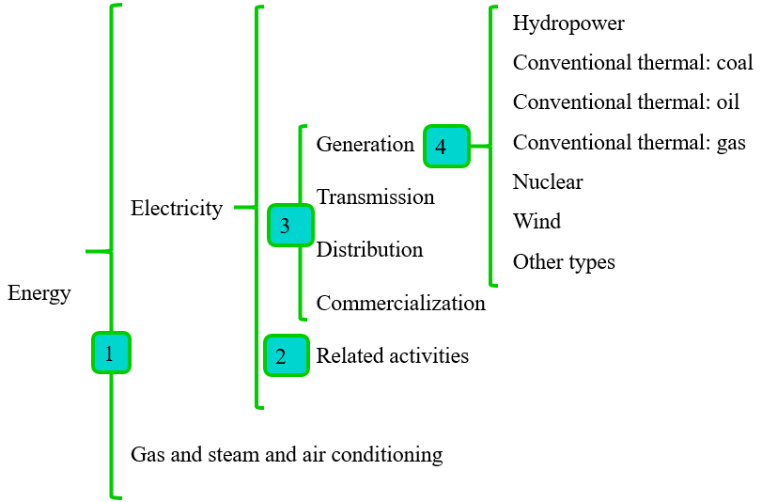
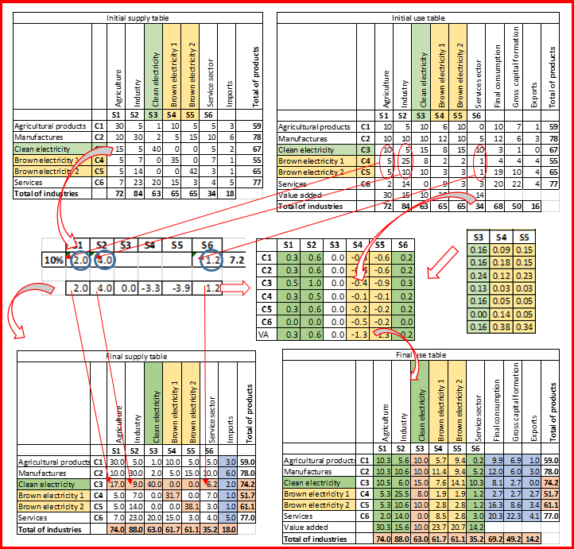
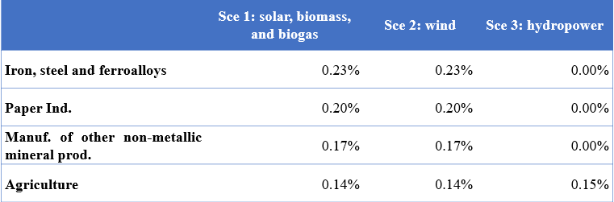
Electricity self-production and self-consumption: An analysis using disaggregated supply and use tables for Spain
Cazcarro, I. ª; Langarita, R. ^{b}; Sarasa, C. ^{b}; Sánchez-Chóliz, J. ^{b}
ª ARAID (Agencia Aragonesa para la Investigación y el Desarrollo)
^{b} Universidad de Zaragoza, rlan@unizar.es
OBJETIVOS / OBJECTIVES
METODOLOGÍA / METHODOLOGY
Analyze the economic and environmental effects of an increase of the electricity self-production and self-consumption under different technological scenarios: (1) Solar, biomass, and biogas; (2) Wind; (3) Hydropower; (4) Self-consumption in households.
Additional contributions:
The high level of disaggregation (several productive activities and different electricity sources).
Disaggregation process in SUTs:
GRÁFICOS Y TABLAS / GRAPHS AND TEXT
RESULTADOS / RESULTS
Self-production:
Electricity from conventional thermal decreases.
VA generated by the initially electricity industries decreases.
Imports, exports and final consumption of conventional thermals decrease.
Self-consumption: largest increases in production in Generation of Electricity from other types, Manuf. of iron, steel and ferroalloys, Paper Ind., and Graphical arts and reproduction of recorded media.
Emissions decrease more with self-consumption.
CONCLUSIONES / CONCLUSIONS
Positive environmental results for the economy without a reduction in production.
Methodological proposal to deal with the challenge of the electricity self-production and self-consumption.

