Slide 1

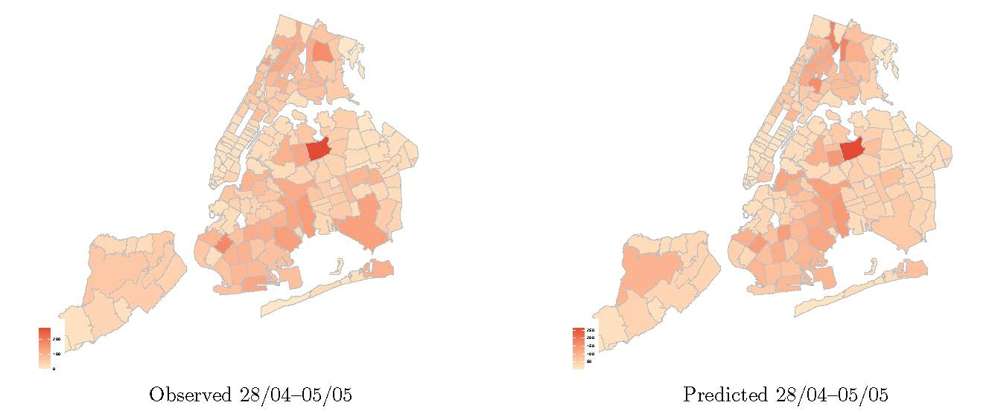
Modelling the spread of COVID-19 in New York City
Jose Olmo / Marcos Sanso-Navarro
University of Southampton / Universidad de Zaragoza
J.B.Olmo@soton.ac.uk / marcossn@unizar.es
OBJETIVOS / OBJECTIVES
METODOLOGÍA / METHODOLOGY
The main goal of this paper is to predict the increase in the number of confirmed cases at the zip code level.
We concentrate on the initial period of the pandemic (From March 31 to June 16, 2020)
We propose a Poisson regression model for count data that includes a large set of covariates reflecting socioeconomic conditions at neighbourhood level (from the ACS) and spatial effects.
The sensitivity of the predictions is controlled for by also considering an emsemble prediction model given by Bayesian model averaging.
GRÁFICOS Y TABLAS / GRAPHS AND TEXT
RESULTADOS / RESULTS
Texto / Text
Population size, age structure, self-employment, income per capita, and the share of workers in the educational and healthcare sectors not only explain the cross-sectional variability of new confirmed cases but also have out-of-sample predictive ability.
CONCLUSIONES / CONCLUSIONS
REFERENCIAS / REFERENCES
Our pointwise forecasts display reasonable MSPE and the associated interval forecasts accurate empirical coverage probabilities suggesting the suitability of the methodology for prediction of the number of infections.
Almagro and Orane-Hutchinson (2020); Clyde (2020); Cordes and Castro (2020); Steel (2020).

